Slide 1

“Eval” in Software 3.0

Slide 3

Rethinking the “evaluation” of
AI-powered systems
Fabio Casati

Slide 4

How “reliable” is this measure (and its color)?
Technical accuracy
89%

Slide 5
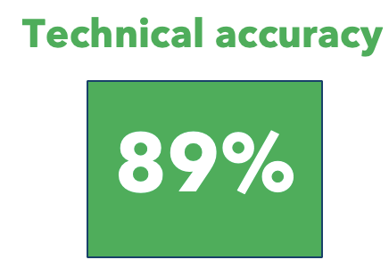
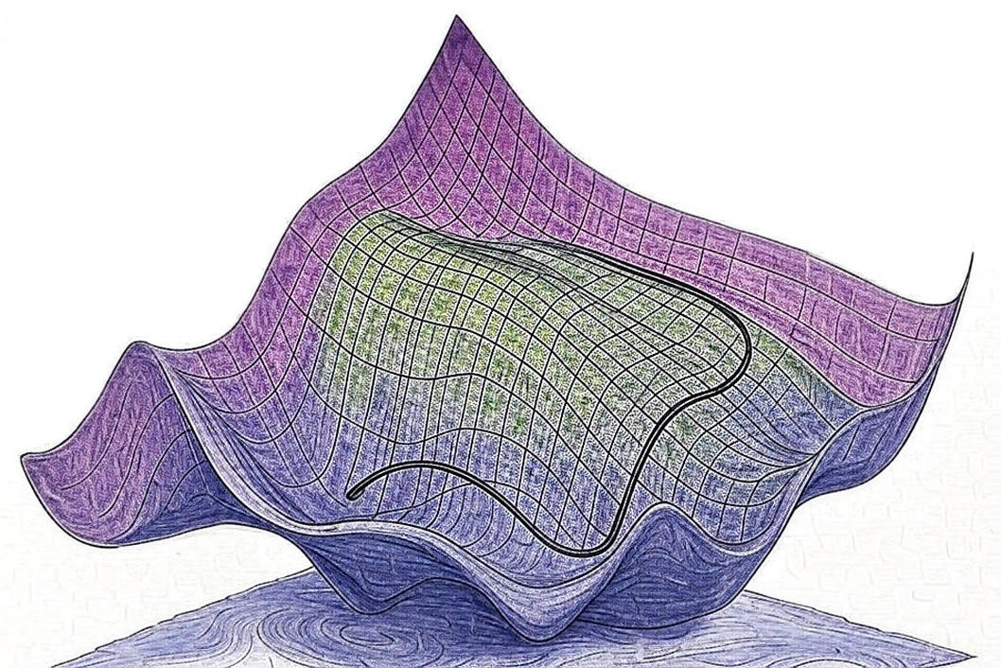
“Eval” in AI systems has a foundational role.
  Ship / no ship decision
  They tell us where to improve
  SW companies are awesome once they know what to optimize for.
  With accurate “eval” you *will* get a good system

Slide 6
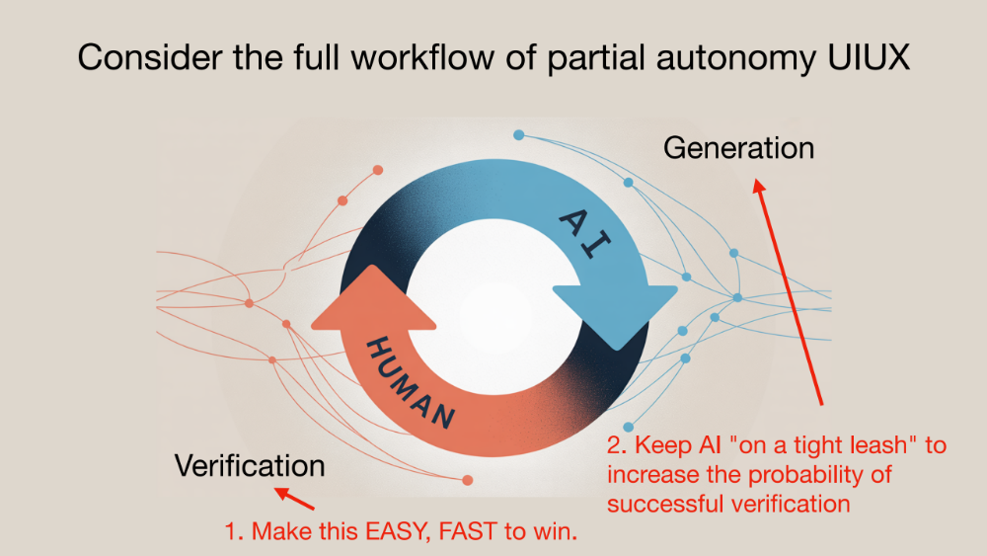
Andrej Karpathy,
At AI Startup School
Can we reliably
automate this, too?

Slide 7
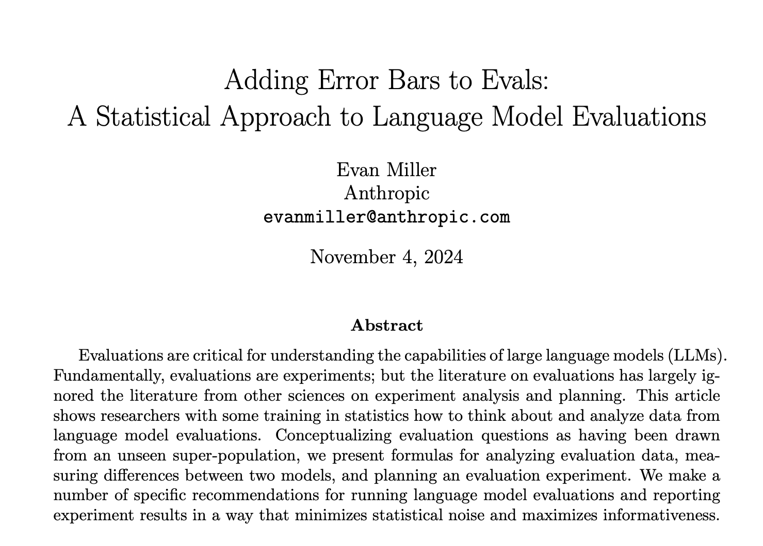
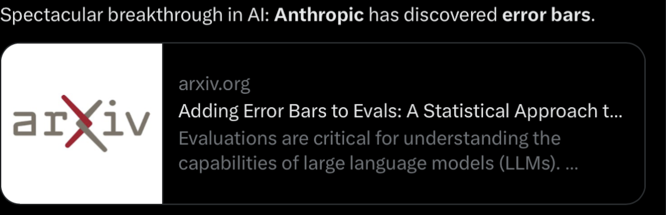

Technical accuracy
89%
Between 60% and 92%
Between 87% and 91%

Slide 8
“Any measurement, without knowledge of the uncertainty, is meaningless.”
- Walter Lewin
“I want you to hear this at 3am tonight when you wake up”

Slide 9
“Any measurement, without knowledge of the uncertainty, is meaningless.”
- Walter Lewin
“If such measurement is reported, it goes from meaningless to misleading”
- Just me

Slide 10
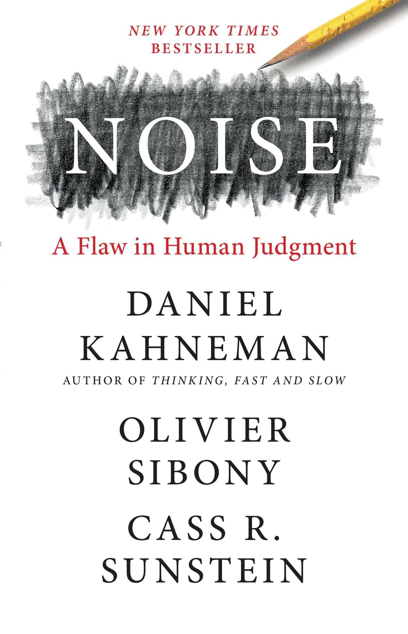
“Most organizations prefer consensus and harmony over dissent and conflict.”
Organizations rarely recognize and accept the existence of noise (bias, too)
My buddy Andy: “yeah, there is a standard deviation”

Slide 11
Visibility, Culture, Action
The visibility problem (epistemic): Are we aware of the uncertainty?
The culture problem (organizational): Do we ask about it? Do we ignore it? Do we reward quantifying it?
The action problem (methodological): What can we do about it?

Slide 12

A brief history of software engineering

Slide 13
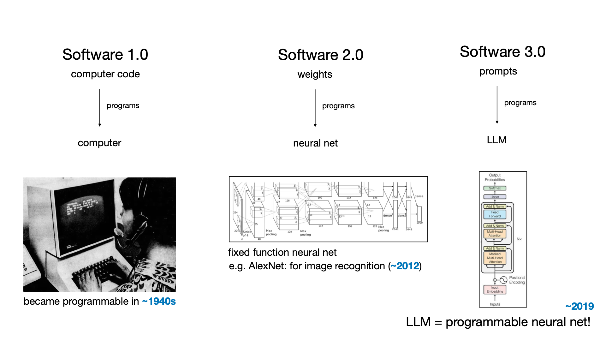
“Software is changing, again” – Andrej Karpathy

Slide 14
 | Software 1.0 | Software 2.0 | Software 3.0
What constitutes progress? What’s an Iteration (sprint)
How do we define and measure quality?
Who (which personas / profile) achieves and measures progress?
Which engineering processes and practices do teams follow?

Slide 15
 | Software 1.0
What constitutes progress? What’s an Iteration (sprint)
How do we define and measure quality?
Who (which personas / profile) achieves and measures progress?
Which engineering processes and practices do teams follow?
Features and bug fixes
Example - apple
Num and “importance” of features delivered
Closed defects
Test cases
Acceptance testing
Everything is documented, reviewed, approved.
Aims at predictable, agreed behavior. No surprises
Dev: Software engineers
QA: Quality assurance engineers
Agile: Scrum, sprint,
Pull request /review, code reviews, …
Mature repo mgmt, merge processes, versioning

Slide 16
 | Software 2.0 (“traditional” ML models)
What constitutes progress? What’s an Iteration (sprint)
How do we define and measure quality?
Who (which personas / profile) achieves and measures progress?
Which engineering processes and practices do teams follow?
Improve model “quality” and latency
(feature at the core is “predict”)
Scorecards – but defining absolute or relative
quality is hard
Process varies. Good practices still emerging
Behavior not always predictable (test cases??)
Dev: Data scientists / ML engineers
Eval: Data scientists / ML engineers + PM / Process Owners
Agile: Scrum, sprint, (eg for model arch changes)
+
Ad hoc / platform or problem specific update cycle
Brittle versioning / code / model mgmt process

Slide 17
Let’s start simple: evaluating classifiers
Predicted Actual | Distribution | Request time off | HR policy inquiry | HR complaint
Request time off | 70% | 80% | 10% | 10%
HR policy inquiry | 20% | 15% | 80% | 5%
HR complaint | 10% | 3% | 17% | 80%
Model 1
Accuracy: 80%
Predicted Actual | Distribution | Request time off | HR policy inquiry | HR complaint
Request time off | 70% | 70% | 15% | 15%
HR policy inquiry | 20% | 15% | 80% | 5%
HR complaint | 10% | 1% | 4% | 95%
Model 2 Accuracy: 74.5%

Slide 18
Let’s start simple: evaluating classifiers
Predicted Actual | Distribution | Request time off | HR policy inquiry | HR complaint | Don’t know
Request time off | 70% | 80% | 10% | 5% | 5%
HR policy inquiry | 20% | 10% | 80% | 5% | 5%
HR complaint | 10% | 3% | 17% | 80% | 0%
Model 1
Accuracy: 80%
When predicted: 80%
Predicted Actual | Distribution | Request time off | HR policy inquiry | HR complaint | Don’t know
Request time off | 70% | 70% | - | - | 30%
HR policy inquiry | 20% | - | 80% | - | 20%
HR complaint | 10% | - | - | 95% | 5%
Model 2
Accuracy: 74.5%
When predicted: 100%
Notes:
]

Slide 19
Eval in “classical” ML and search is HARD
Search: still today people debate between precision, recall, one-shot result, link position,…
Clustering: the only real unsupervised task, can only be assessed by humans
Classification: seemingly simple, but subjective and non directional
…
One point in favor: we often have lots of data =>
we can test at scale, and with the ”right” data

Slide 20
Gen AI and software 3.0

Slide 21
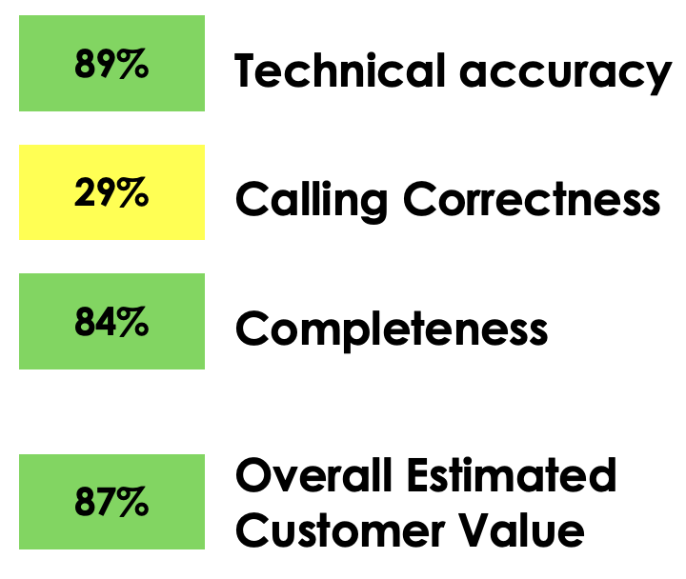
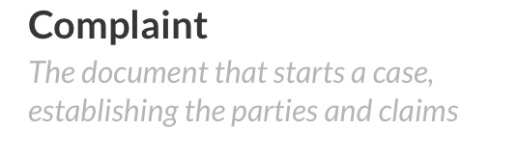
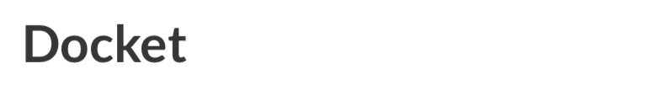
Summary
2005 class action settlement resulted in ACME paying $8.55m to redesign its selection process for apprenticeship programs to address the previous process’s disparate impact on Black applicants.
LLM-powered Lawsuit Summarizer
“Eval”
Legal Proceedings
Notes:
We will see that is not the only system under eval (as we eval the eval, too)

Slide 22
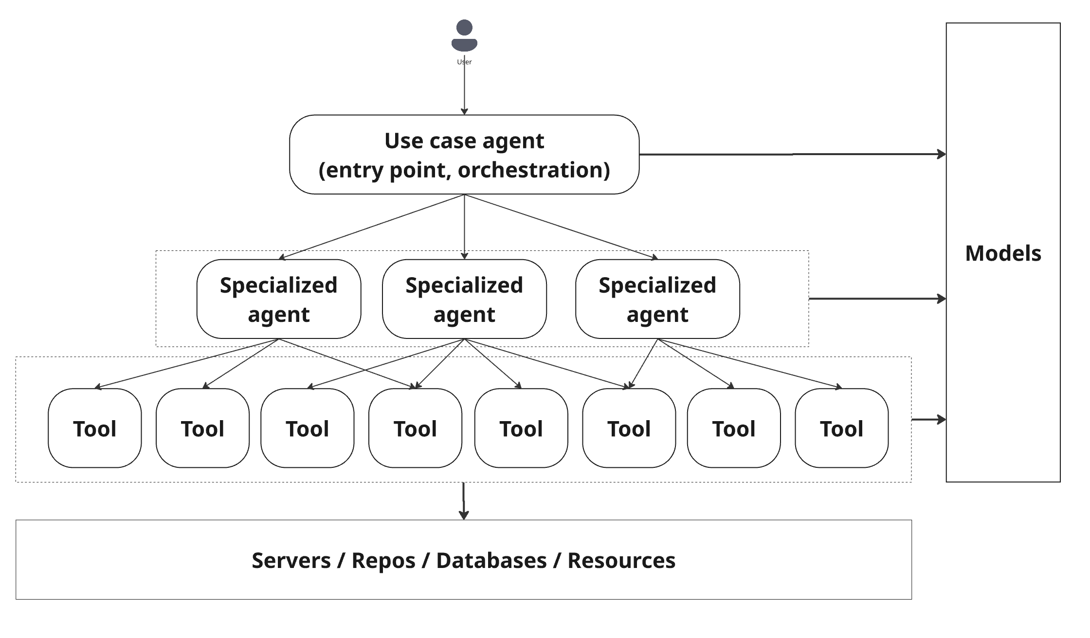
LLM-powered Lawsuit Summarizer

Slide 23
 | Software 1.0 | Software 2.0 | Software 3.0
What constitutes progress? What’s an Iteration (sprint) | Features + bug fixes | Improve model quality and latency | ?
How do we define and measure quality? | Feature importance Closed defects | Rooted in science + perceived customer value But, somewhat arbitrary | ?
Who (which personas / profile) achieves and measures progress? | Dev eng QA eng | ML Eng / data scientists | ?
Which engineering processes and practices do teams follow? | Established practices. Agile. Repo mgmt. Review / approval cycles Clear RACI | Varied and still emerging practices. Less review, approval, predictability Clear RACI | ?

Slide 24
 | Software 1.0 | Software 2.0 | Software 3.0
What constitutes progress? What’s an Iteration (sprint) | Features + bug fixes | Improve model quality | ?
How do we define and measure quality? | Feature importance Closed defects | Science + customer value But, somewhat arbitrary | ?
Who (which personas / profile) achieves and measures progress? | Dev eng QA eng | ML Eng / data scientists | ?
Which engineering processes and practices do teams follow? | Established practices. Review / apprv Clear RACI | Varied practices. Less control Clear RACI | ?
Improve AI agent quality + latency

Slide 25
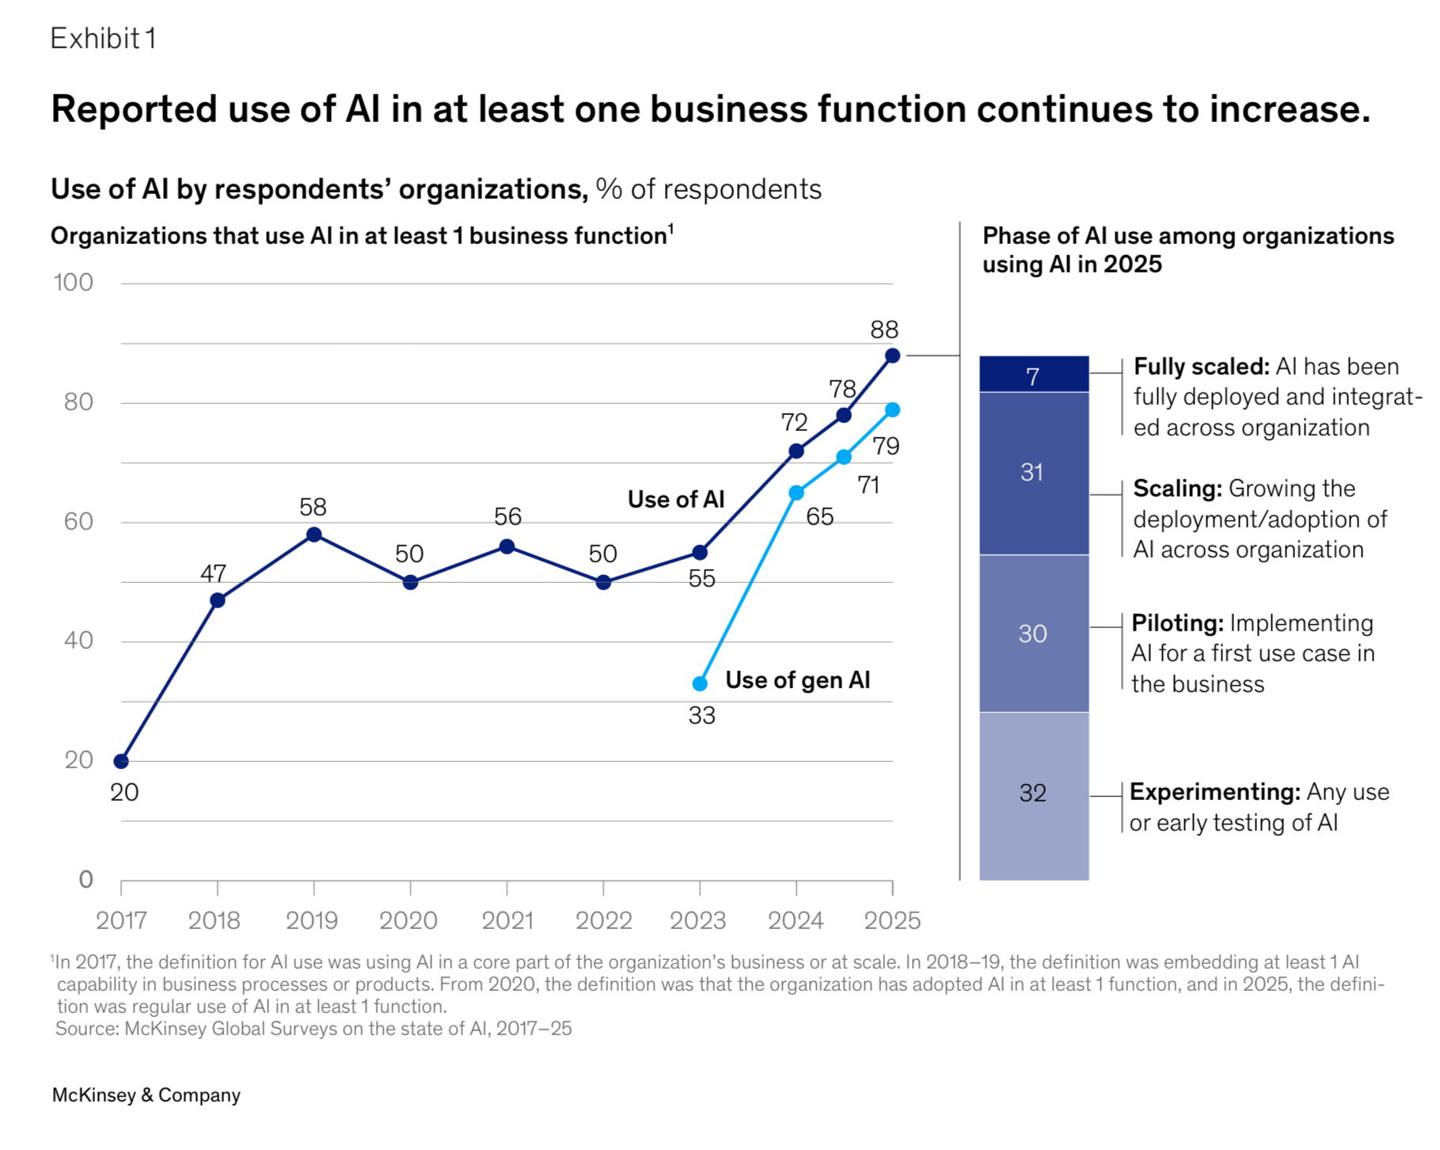
AI becomes
Good
Easy to use (double-edged sword)
Applicable to many high value use cases
Successfully used by kids of CTOs / CEOs

Slide 26
We are not building toys
LLM-powered Lawsuit Summarizer
We are building a
  complex distributed software system
  composed of a mix of deterministic and ambiguously defined services
  that produces output that is hard / subjective to assess
  potentially very consequential
“Easy” to build, hard to assess of we built it “right”.
This is new to software 3.0
Notes:
Over-agentification

Slide 27
How do we eval?
Summary
2005 class action settlement resulted in ACME paying $8.55m to redesign its selection process for apprenticeship programs to address the previous process’s disparate impact on Black applicants.
LLM-powered Lawsuit Summarizer
Legal Proceedings

Slide 28

First idea: “Vibe eval”
Summary
Plaintiffs allege that Defendant sold devices with defective batteries that degrade far faster than reasonable, causing rapid power loss, overheating, and unexpected shutdowns. Defendant knew …
Lawsuit summarizer
CTO
“Summarize this class action lawsuit about phone battery depletion”

Slide 29
Vibe eval was actually common practice for a while…
Until two things happened:
It became clear that teams “overfit to the CTO”
Process owners thought: “maybe we can have some rigor in evaluating our highly consequential system”

Slide 30
New idea: let’s get organized: metrics and golden datasets
User utterance | Available tools | Expected tool calls | Expected final answer
I forgot my Windows password, can you reset it? | USER_DIRECTORY, PASSWORD_RESET, EMAIL_SERVICE | 1) USER_DIRECTORY(email=user) → verify identity 2) PASSWORD_RESET(user_id) → create reset token 3) EMAIL_SERVICE(user, reset_instructions) | Explains that a reset link has been sent to corporate email, with simple steps and expected timing to regain access.
My VPN stopped working after I changed my laptop. | USER_DIRECTORY, VPN_PORTAL, TICKET_CREATE | 1) USER_DIRECTORY(email=user) 2) VPN_PORTAL(user_id, action=check_profile) 3) VPN_PORTAL(user_id, action=reset_or_reprovision) 4) TICKET_CREATE(details) | Confirms user identity, explains that VPN profile was reset/reprovisioned, documents ticket number, and gives concrete retry instructions (reconnect steps).
I joined Sales EMEA and can’t access MyZForce. | HR_SYSTEM, LICENSE_MANAGER, TICKET_CREATE | 1) HR_SYSTEM(lookup_user) → get role+region 2) LICENSE_MANAGER(assign_salesforce_license, tier=correct_for_role_region) 3) TICKET_CREATE(details) | States that appropriate MyZForce license was requested/assigned, gives expected activation time, and shares tracking ticket or reference ID.
… | … | … | …

Slide 31
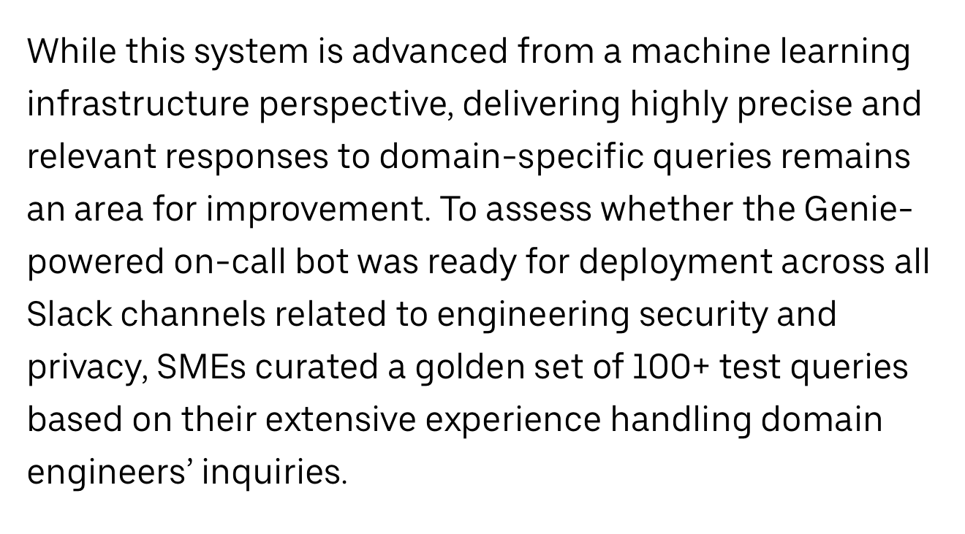
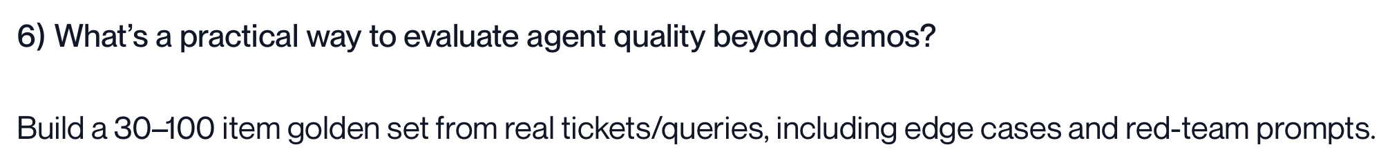
Golden dataset with ground truth: the mythical 100 and the regression test mindset
“50” or “100” are responses to vibe testing, which is ~5 examples.
It seems a small number – but creating golden dataset is HARD

Slide 32
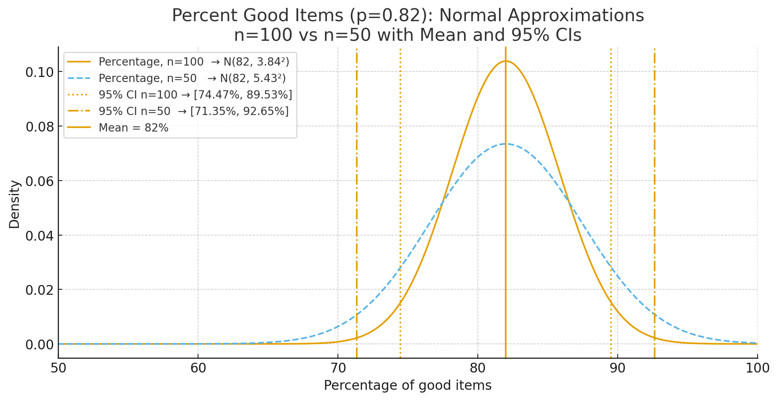
Potential Issues with golden dataset /1: size

Slide 33
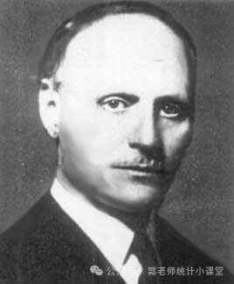
Golden dataset /2: overfitting and multiple hypotheses testing
Test case / Regression tests mindset
As developers we may tend to overfit to these 100 examples
A common approach to prevent overfitting is to hide the golden dataset from developers
But, we are still testing multiple variants on the same dataset….

Slide 34
Golden dataset /3: representativeness
Multiple “dimensions” of diversity
Enterprise data differs from benchmarks
Synthetic data often massively oversimplified
And all this even assuming we know how to compare an answer with the ground truth
synthetic: I was charged twice on my last bill. Please refund the extra charge.
Very different than software 2.0
real: Ciao, non riesco più a loggarmi nell’app after midnight e in più mi avete charged twice this month 😡 Potete sistemare sia l’accesso for user fly75 che la double charge per favore? Right now!!

Slide 35
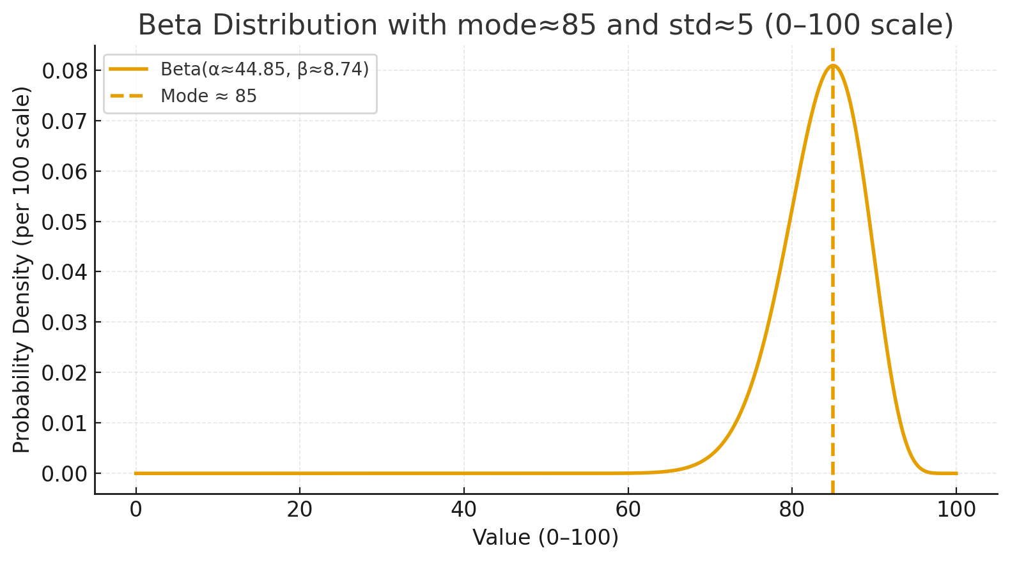
Tuning our beliefs
“Our evals are not perfect, but, crawl walk run.
They give us some reasonable feedback to work with, and we will keep improving it.”
Point estimate

Slide 36
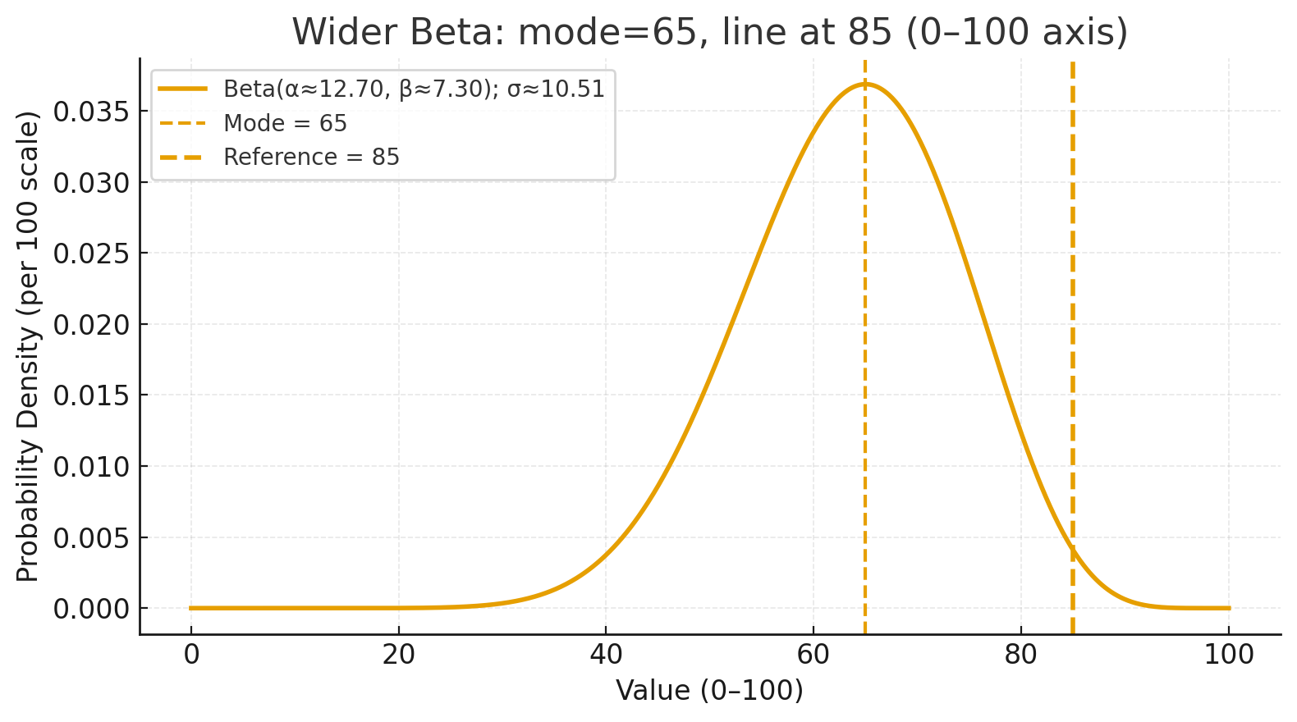
Tuning our beliefs
Actual distribution
Point estimate
Notes:
Bias plus variance

Slide 37
Next idea:
LLM as a Judge
Summary
2005 class action settlement resulted in Ford paying $8.55m to redesign its selection process for apprenticeship programs to address the previous process’s disparate impact on Black applicants.
AI-powered service
LLM judge “Eval”
Eval results
Legal Proceedings
Examples – at scale

Slide 38
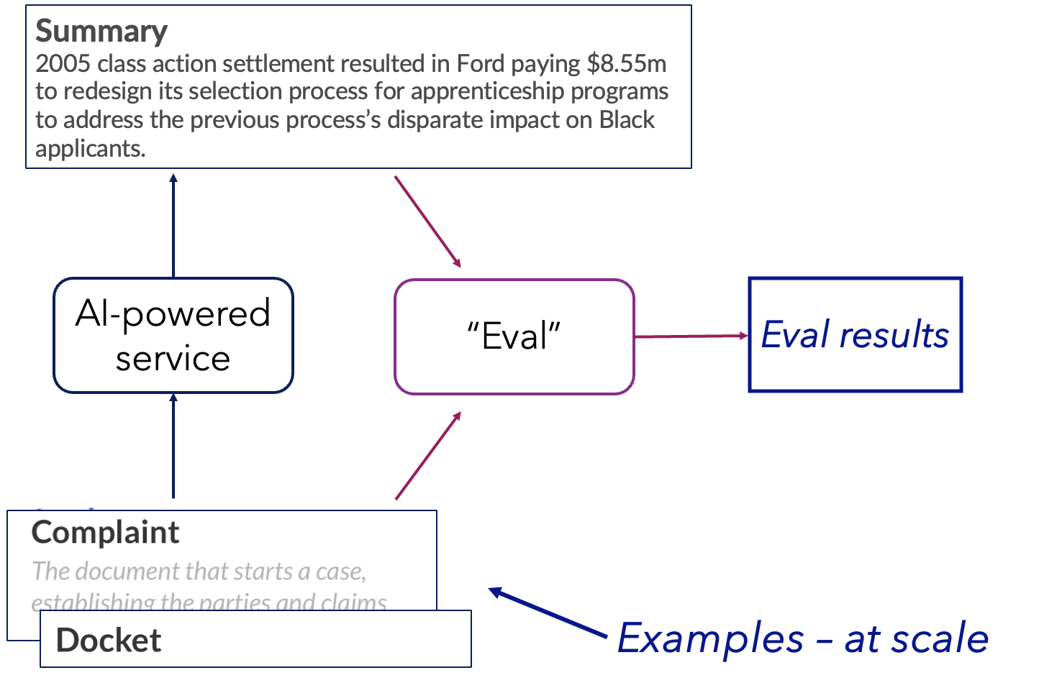
Next idea:
LLM as a Judge
No need for ground truth
Still requires “calibration”

Slide 39
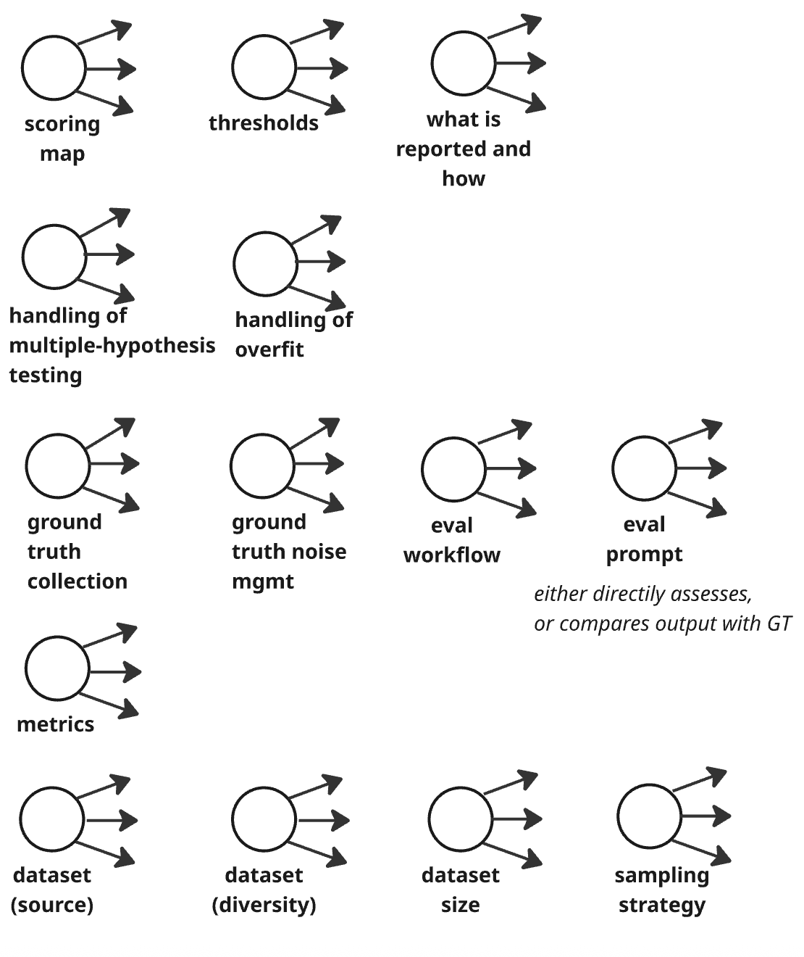
Decisions we need to take in an eval process
Reporting
Over-reliance
Technical accuracy
Determination of “correct”
89%
Metrics
Data

Slide 40
Each decision significantly affect outcome
They are non-trivial

Slide 41
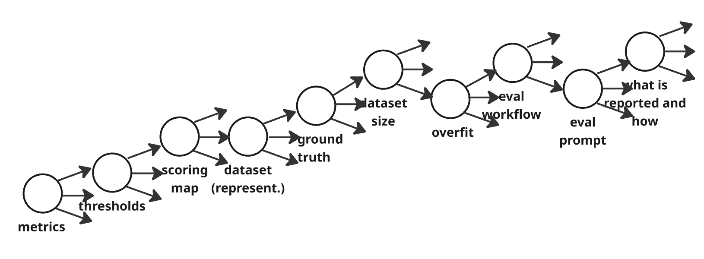
Each dimension adds variability

Slide 42
Next idea: give mandates, practices, tools, artifacts
  Best practices
  Mandates
  Tools
  Metrics
  Prompts to eval those metrics
  Curated datasets
  …

Slide 43
Mandates and tools without a proper accountability structure shift responsibility

Slide 44
 | Software 1.0 | Software 2.0 | Software 3.0
What constitutes progress? What’s an Iteration (sprint) | Features + bug fixes | Improve model quality | ?
How do we define and measure quality? | Feature importance Closed defects | Science + customer value But, somewhat arbitrary | ?
Who (which personas / profile) achieves and measures progress? | Dev eng QA eng | ML Eng / data scientists | ?
Which engineering processes and practices do teams follow? | Established practices. Review / apprv Clear RACI | Varied practices. Less control Clear RACI | ?
Improve AI agent quality + latency
Scorecard.
Varying degree of maturity in measurement
Dev: SW eng, PMs, process owners
Eval: wide range of people and roles
Practices for dev, review, code mgmt, docs, … still to emerge
Unclear RACI

Slide 45
Big problem = big opportunities
We need scientific rigor → but we can't have it at scale
Mandates mean well → but they can shift responsibility
Centers of Excellence → do they scale?
Wait for ecosystem maturity → we're shipping now

Slide 46
Call to action: what can we do?
A lot, actually
Technical accuracy
89%
The two simplest and most effective solutions:
Naming things right. “Eval” --> “Estimation of a random variable”
Asking the question.
How “reliable” is this measure (and its color)?
Which range would you be comfortable telling your customer?

Slide 47
Put science – and a sprinkle of process - back into engineering, at scale
We can’t put reliable data scientists in every team. But we have to scale quickly.
We build scaffolding that guides teams toward rigor:
Methods that force the right questions — self-reflection
Agents that know science of eval and team up with you
  helps you make sure decisions are well grounded, intentional, explicit, documented, reviewed
Reporting practices that make clear what we know and what we don’t know

Slide 48
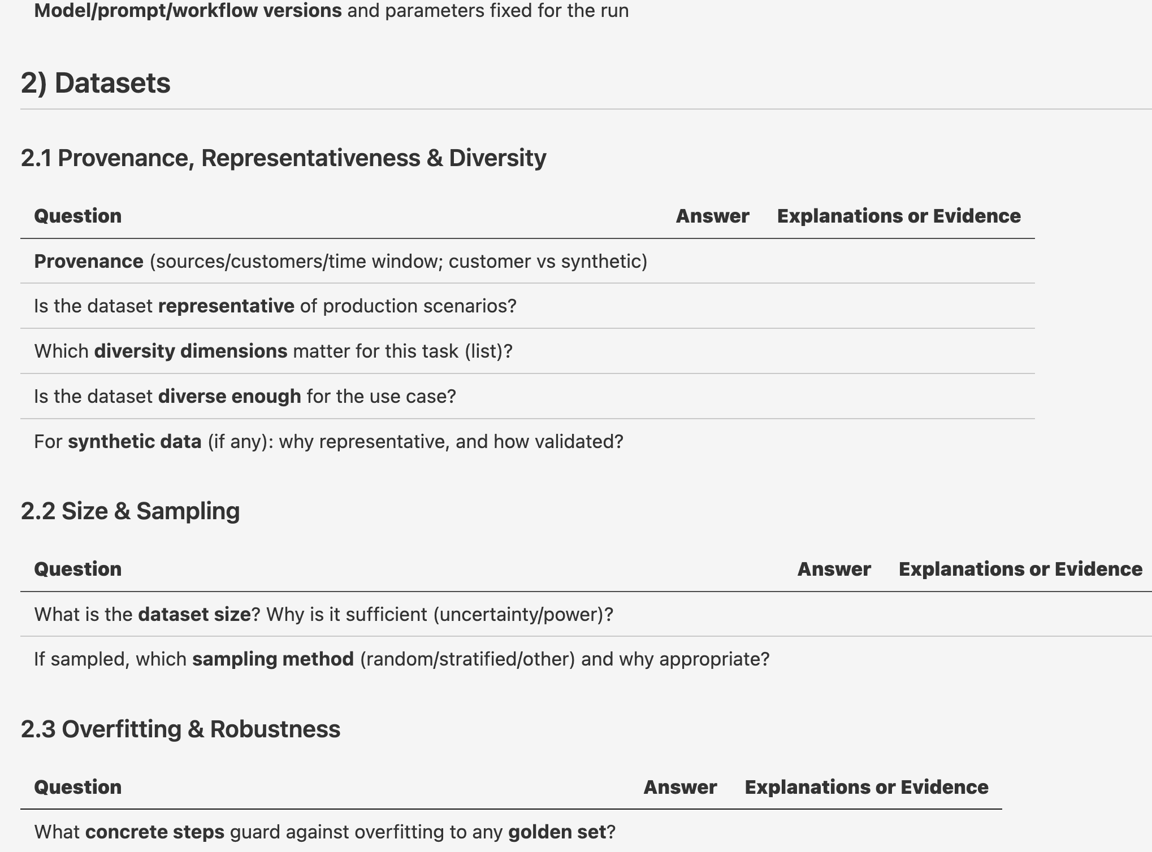
Example: Worksheets as thinking tools
And quick review / feedback
Elicit what we do not know

Slide 49
Example (2): AI Eval Center of Excellence – at your fingertips
Fills the worksheet from “eval” reports and conversations with teams
Aware of “good” principles and company’s practices
Guides and trains by example, in the process, suggests improvements
Captures collective insights
Helps decision maker

Slide 50
RACI and estimation as a first-class citizen
Each “box” has to have a person/team accountable for statements about its quality
Make estimation as important and structured as dev

Slide 51
Reusing and adapting good engineering practices
Agents are complex distributed systems – and we have experience in building them right
Which abstractions should be “first class” citizens? Which ones allow us to isolate problems and sources of variability?
  Assertions and Exception – avoiding silent failures
  Desirable execution paths
  Logging
Reporting dashboard (that show uncertainty)

Slide 52
Eval in Software
1.0 vs 2.0 vs 3.0
05
How evaluation paradigms evolve across software generations

Slide 53
Eval in Software 1.0 vs 2.0 vs 3.0
How evaluation paradigms evolve across software generations
 | Software 1.0 | Software 2.0 | Software 3.0
Nature of use cases | Features are clear and well-described. Output is measurable and predictable. | Relatively small number of distinct use cases in production. Model predictions on structured data. | Complex, often subjective use cases. Many things we want from a "good" answer. Eval is multifaceted.
Ground truth availability | Reviewed and approved test cases. Clear expected behavior. | Relatively easy to get ground truth data. Large test sets available. | Hard to get ground truth – esp. if it requires human labeling. Hard to even know if an answer matches the ground truth.
Metrics & measurement | Output is measurable. Regression and updates checked against test cases. | Metrics perceived to be understood. Gap between what is measured in literature and what matters in business. Harder than people think. | Subjectivity and disagreement among labelers must be measured. Hard to define what "correct" means. Eval is multifaceted – many dimensions of quality.
Who leads eval | PMs and QA engineers. | PMs and data scientists. | Wide range of people and roles (SW eng, PMs, process owners). Unclear RACI.
Approach to scale | Test cases + acceptance testing. Deterministic: run once, trust the result. | Large datasets, including large test sets. Scale through data volume. | LLM as a judge as a potentially useful approach to get scale. Still requires calibration.
Model & variability | Deterministic code. Same input → same output. | Model often trained on customer datasets. Practices were slowly maturing when 3.0 barged in. | Often one model for all customers – need to understand variance. Models change more or less under our nose.
Maturity of practices | Mature. Established review and approval cycles. | Slowly maturing. Measuring and doing evals is harder than people think. | Still emerging. Many open questions. No established playbook.
Notes:
Here I want to begin to describe what is different
1.0;
Reviewed and approved feature description and test cases. Features mostly clear and well described. Output is measurable
Regression and updates are checked against test cases
Eval led by PMs and QA engineers
2.0:
Large datasets. Including large test sets. Metrics perceived to be understood, even if there is a gap between what is measured in scientific literature and what matters in business. Measuring and doing evals is harder than people think.
Relatively easy to get ground truth data.
Eval led by PMs and data scientists
Model often trained on customer datasets
The concepts and practices were slowly maturing when gen AI and 3.0 barged in.
Relatively small number of distinct use cases in prod
3.0
Complex and often subjective use cases
Hard to get ground truth – esp if it requires human labeling
Subjectivity and disagreement among labelers must be measured
Hard to even know if an answer is in line with the ground truth once we see it
LLM as a judge as potentially useful approach to get scale
Often one model for all customers – we need to understand variance (or implement variations)
Models change more or less under our nose.
Eval is multifaceted, there are many things we want from a “good” answer

Slide 54
Thanks :)

